Slide 1
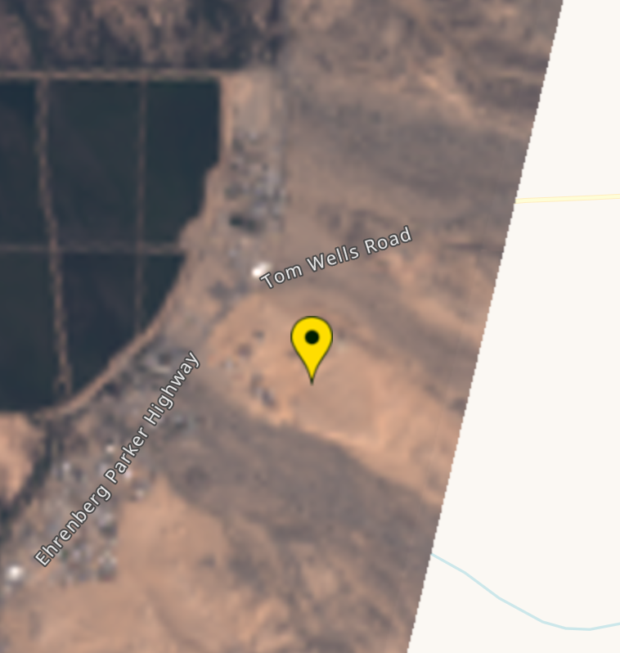
Stanford Gas Release Experiment
Methane Detection using Multispectral Instruments
Contribution from SRON, Leiden, The Netherlands
Date | Time (UTC) | Satellite | Successful methane Retrieval? | Assessment
21/10/17 | 18:22 | Sentinel-2 | Y | No plume
21/10/19 | 18:25 | Sentinel-2 | Y | Plume
21/10/21 | 18:11 | Landsat-8 | Y | Plume
21/10/22 | 18:35 | Sentinel-2 | Y | Plume
21/10/24 | 18:25 | Sentinel-2 | N | Cloudy
21/10/27 | 18:35 | Sentinel-2 | Y | Plume
21/10/28 | 18:16 | Landsat-8 | N | Clipping issue*
21/10/29 | 18:25 | Sentinel-2 | Y | No plume
21/11/1 | 18:35 | Sentinel-2 | N | Cloudy
21/11/3 | 18:25 | Sentinel-2 | Y | No plume
*Not enough observations around the location to perform a retrieval. See image

Slide 2
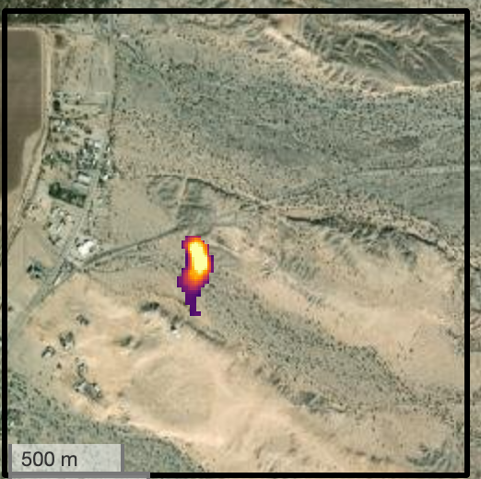
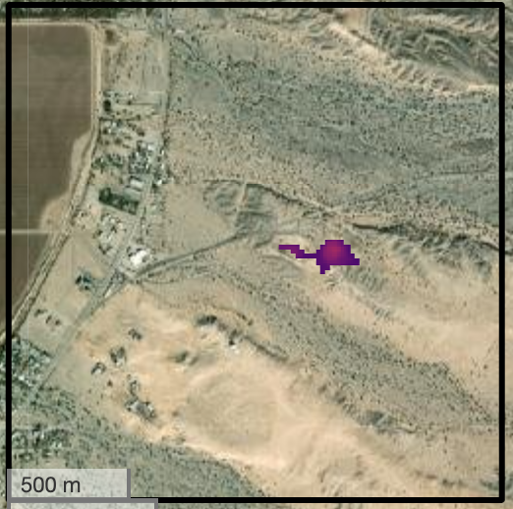
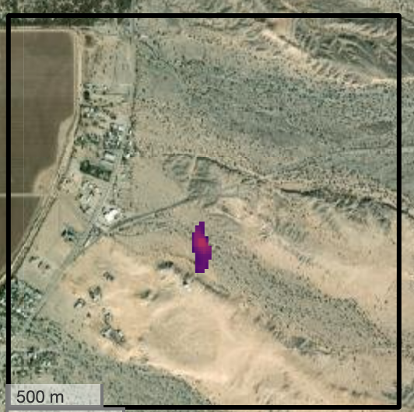
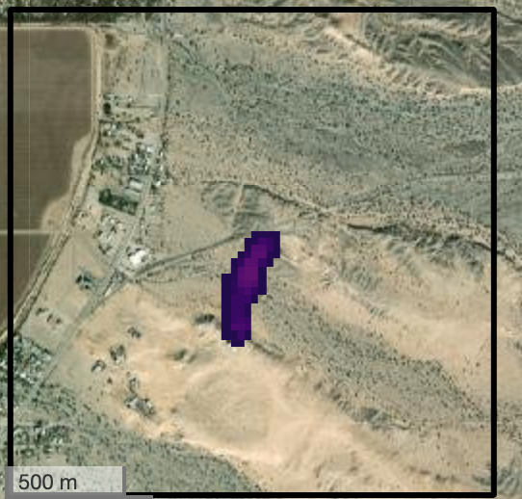
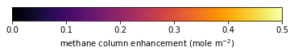
Emission estimates using reanalysis wind data
Date (satellite) | Plume length (m) | FacilityEmissionRate (kg/hr) | FacilityEmissionRateLower (kg/hr) | FacilityEmissionRateUpper (kg/hr) | UncertaintyType | Windspeed (m/s) [min-max*] | Wind Direction (azimuth degree)
2021-10-19 (S2) | 340 | 3760 | 1970 | 6260 | Min/max | 1.8 [0.8-2.9] | 175
2021-10-22 (S2) | 330 | 1160 | 570 | 2590 | Min/max | 1.4 [0.6-3.2] | 92
2021-10-27 (S2) | 260 | 2250 | 1440 | 2870 | Min/max | 3.8 [2.6-4.4] | 184
2021-10-21 (L8) | 490 | 1810 | 1418 | 2110 | Min/max | 2.2 [1.7-2.4] | 186
*Wind data are taken from ERA5 and GEOS-FP reanalysis at 1700, 1730, 1800, 1830, 1900, 1930 UTC.
Gas release location: latitude= 33.6306, longitude-114.4895
2021-10-19 (S2)
2021-10-22 (S2)
2021-10-27 (S2)
2021-10-21 (L8)
Background image credit : Esri, NASA, NGA, USGS, FEMA | County of Riverside, California State Parks, Esri, HERE, Garmin, SafeGraph, GeoTechnologies, Inc., METI/NASA, USGS, Bureau of Land Management, EPA, NPS, US Census Bureau, USDA | Maxar

Slide 3
Emission estimates using measured wind data
Date (satellite) | Plume length (m) | FacilityEmissionRate (kg/hr) | FacilityEmissionRateLower (kg/hr) | FacilityEmissionRateUpper (kg/hr) | UncertaintyType | Windspeed (m/s) [Min-Max]* | Wind Direction (azimuth wind vector)
2021-10-19 (S2) | 340 | 4680 | 3410 | 6000 | Min/max | 2.6 [1.7-3.4] | 197
2021-10-22 (S2) | 330 | 1500 | 1203 | 1790 | Min/max | 1.9 [1.4-2.3] | 113
2021-10-27 (S2) | 260 | 2380 | 1940 | 2840 | Min/max | 4.2 [3.9-4.4] | 221
2021-10-21 (L8) | 490 | 2780 | 2450 | 3170 | Min/max | 4.1 [3.9-4.4] | 221
*1-minute average during the 3 minutes preceding the satellite overpass time.

Slide 4
Performer Info
(1) Please provide a detailed description of system configuration and primary components including the sensor and deployment platform. Additionally, the location (latitude, longitude, height) of auxiliary components such as meteorological station or any other equipment installed at or near the Test Center must be recorded. | Varon et al. (2021) showed that the measurements from shortwave infrared (SWIR) bands of multispectral satellites instruments (MSI) can be used to detect methane plumes from large point sources and quantify source rates. Here, we use the Sentinel -2 and Landsat-8 MSI to detect and quantify methane plumes. Sentinel-2: Sentinel-2 is a European Earth observation mission. It comprises two multispectral satellites (MSI) positioned 180 degree out of phase in the same sun-synchronous orbit, with an equator-crossing time of 10:30 am (local solar time). Sentinel-2A was launched in June 2015 and Sentinel-2B in March 2017. Each satellite carries an MSI that continuously sweeps the Earth’s surface in 13 spectral bands from the visible to the SWIR at 10–60m pixel resolution over a 290 km cross-track swath (Drusch et al., 2012). The twin satellite configuration enables full global coverage every 5 d and 2–3 d revisit rates at midlatitudes. Landsat-8: Landsat 8 (https://landsat.gsfc.nasa.gov/satellites/landsat-8/, last access: 28 Feb 2022 ) is an American Earth observation MSI launched on 11 February 2013. It is the eighth satellite in the Landsat program. The Landsat mission is a collaboration between NASA and the United States Geological Survey (USGS). Landsat-8 has a 16-day repeat cycle with an equator-crossing time of 10:00 am (local solar time). The Operational Land Imager (OLI) onboard the satellite measures 9 spectral bands at 30-meter spatial resolution. Methane retrievals: We retrieve methane observations from SWIR-band observations of Sentinel-2 (band 11 at 1560–1660 nm and band 12 at 2090–2290 nm) at 20 m pixel resolution. Similarly, We retrieve methane observations from the SWIR bands of Landsat-8 (Band 6 at 1570 - 1650 nm and Band 7 at 2110 - 2290 nm) at 30 m pixel resolution. We use the multi-band–multi-pass (MBMP) method (Varon et al., 2021) to retrieve methane column enhancements. A more detailed description of our retrieval method is given in Pandey et al. (in prep). Plume detection: We first mask the methane retrievals over a scene with a 95 percentile filter. Thereafter, a 3x3 median pixel is applied to remove the isolated pixels. We further discard the albedo artefacts from methane retrieval data using the corresponding RGB band images. The RBG bands are not sensitive to atmospheric methane and therefore can be used as a proxy for albedo artefacts. Emission rate quantification: We perform it using the integrated mass enhancement method (IME, Varon et al., 2021, AMT) using (a) hourly ERA5 and GEOS-FP 10-m wind data, or (b) measured wind data.
(2) Please record the model number of each primary component in (1), if applicable. | N/A
(3) Please record the software revision installed on the components in (1), including performer-specific software components, revisions, or customizations | N/A
(4) Please record the revision number of any software analytics installed offsite. For example software to convert concentration maps to mass emission quantification estimates during the experiments. | N/A
(5) Please describe the expected flight path for testing and how this compares with typical field deployments. For example, a technology deployed in pre-set surveys should have pre-set flight lines (e.g., racetrack or figure-8 formation). A technology that conducts multiple passes for each emission, potentially at different angles of approach, should operate as it would in a field deployment. | N/A
(6) Please define a single survey measurement, as reported in the field. For example, is it a single overflight with hyperspectral imagery or an ensemble of plume transects? Each survey measurement may be composed of multiple subsidiary measurements (e.g., individual plume transects). | Single overflight with MSI satellite imagery.
(7) Please estimate the expected survey time (possibly a function of emission size).
(8) Please specify the flight altitude. | Sentinel-2: 786 km Landsat-8: 705 km
(9) Please provide the confidence level at which emission detection data are reported. (e.g., 95% CI, +/- 1 sigma) | Min/Max values.
(10) Please record the number of personnel participating in the surveys and their roles. Any remote personnel participating in the survey in any fashion should be documented as part of the survey team in this section. Names of individual personnel are not required.
(11) For hyperspectral technologies, describe how plume length is determined for quantification. | The length of plume is measured along the elongated plume direction.
(12) If wind speed is used in computing total emission rate, please describe how the wind estimate is obtained, including the precise instrument or wind reanalysis product used. | 1st stage submission: The overpass times of the four observed plumes are within 1800–1900 UTC hours. We account for errors in wind data by using two reanalysis models at multiple time instances. we use 10-m wind data between 1700–1930 UTC hours from the ERA5 (at 1700, 1800 and 1900) and GEOS-FP (at 1730, 1730 and 1930 ) meteorological reanalysis. 2nd stage submission: The gas release team provided wind measurements at 1-second resolution. We use the minute-average wind data during the preceding 3 minutes of the satellite overpass for emission quantification. The choice of 3 minutes is based on the winds speeds at the overpass time and the observed plume length.

